Slide 1
A proof is a bridge
A series of pictures to illustrate the difference between a good proof, a bad proof, and a non-proof, with a few comments about style and strategy.

Slide 2
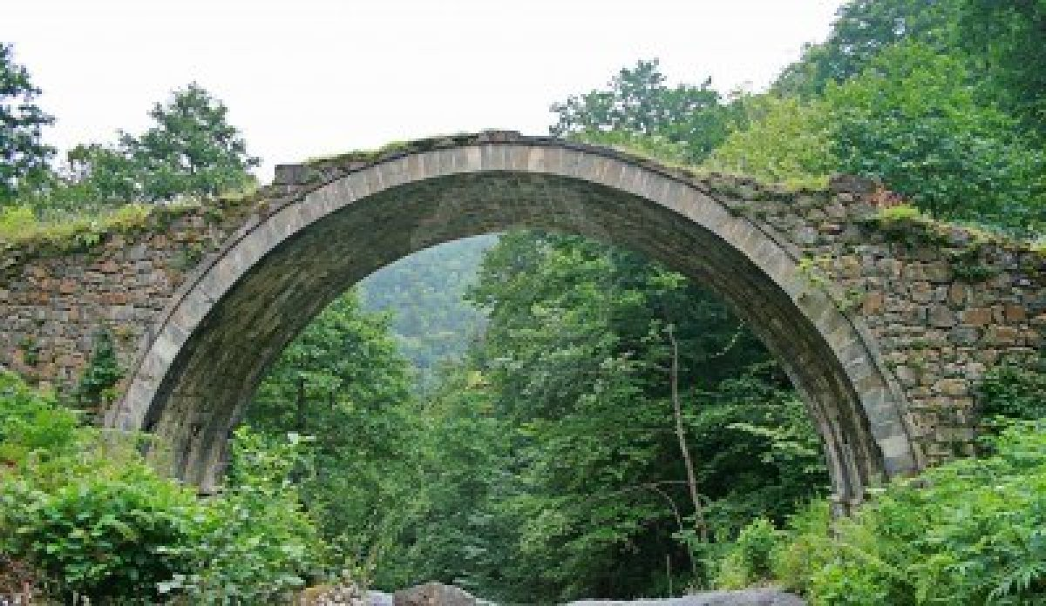
A proof is a bridge from the assumptions to the conclusion
Assumptions
Conclusion
http://www.123rf.com/photo_14634597_historical-stone-arch-bridge-in-black-sea-region-of-turkey.html

Slide 3
A proof is how we know that a mathematical fact is true. We need to be able to trust that it provides a reliable bridge from the assumptions to the conclusion.

Slide 4
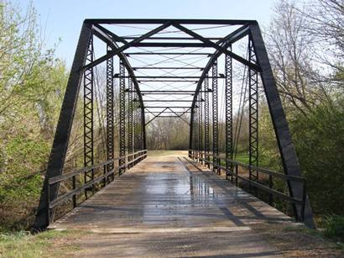
This is a solid bridge
http://www.texasescapes.com/TexasHillCountryTowns/Coupland-Texas.htm

Slide 5
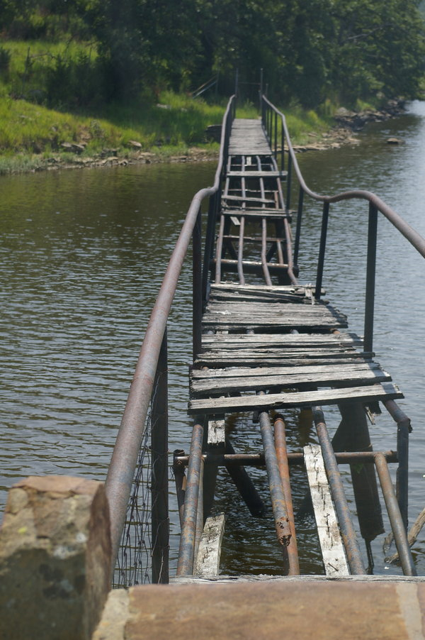
This one has some important steps left out
http://overstocked.deviantart.com/art/Rickety-Bridge-94708710?q=gallery%3Aoverstocked%2F2875302&qo=0

Slide 6
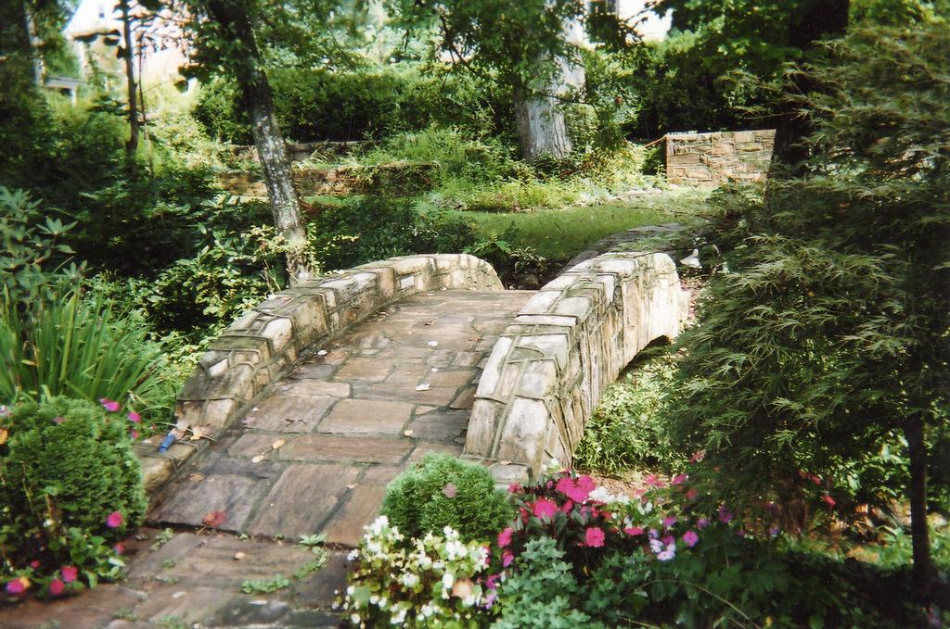
Short but solid
http://www.merchantcircle.com/business/European.Stone.Masonry.919-832-1880/picture/view/1425063

Slide 7
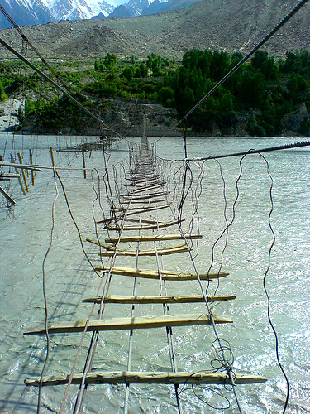
Would you trust this bridge?
http://www.dadsbigplan.com/2010/03/acrophobia-support-group-straight-ahead/

Slide 8
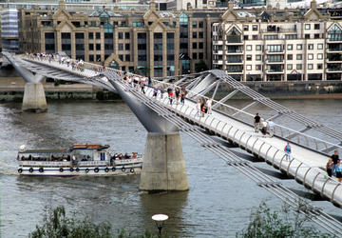
This is a bridge
http://www.pps.org/great_public_spaces/one?public_place_id=658

Slide 9
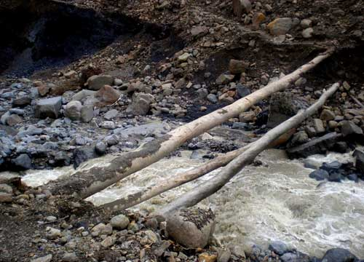
This is a start, but not the kind of bridge we would want to use

Slide 10
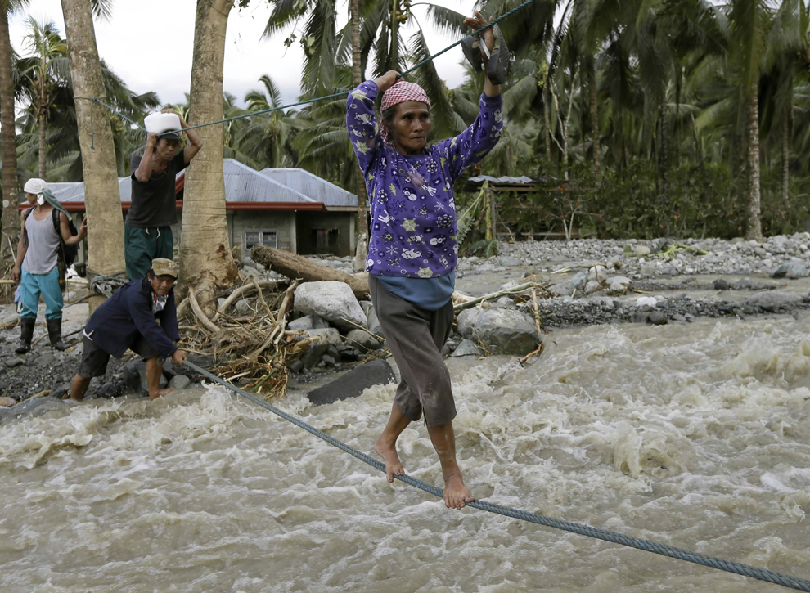
This one asks too much of the user
http://2eyeswatching.com/category/news/

Slide 11
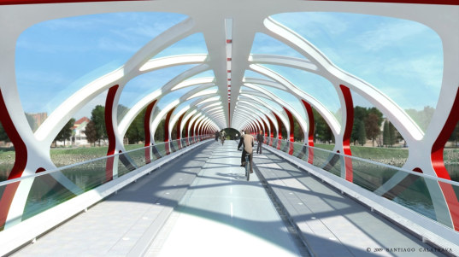
Pleasant to walk across
http://inhabitat.com/calatrava-reveals-new-foot-and-bike-bridge/

Slide 12
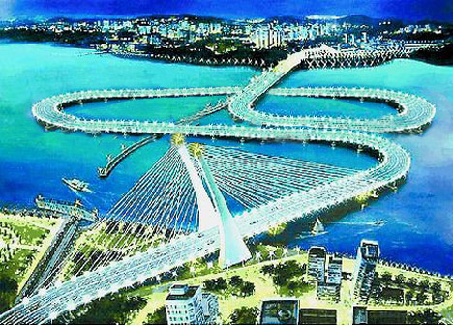
This bridge could be more direct
http://malaysia-today.net/mtcolumns/guest-columnists/32860-an-analysis-of-dr-mahathirs-crooked-bridge

Slide 13
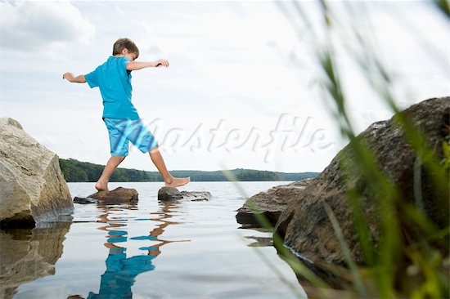
This is fine for exploration, but once you know how to make the connections between the assumptions and the conclusions, make a proper bridge
http://www.masterfile.com/stock-photography/image/839-03295707/Boy-stepping-stones-in-water

Slide 14
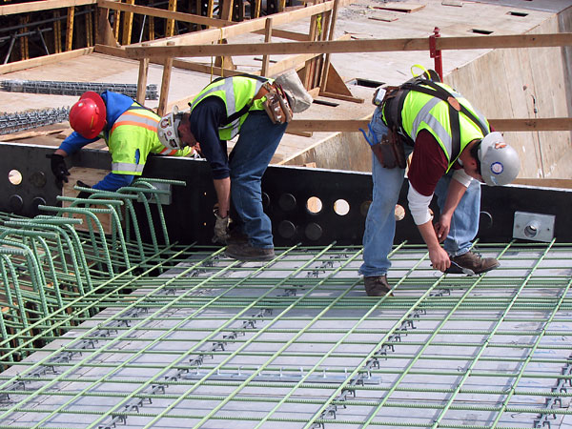
It takes time, work, and attention to detail to make a good proof
http://minnesota.publicradio.org/display/web/2008/05/21/35w_bridge_reconstruction_tour

Slide 15
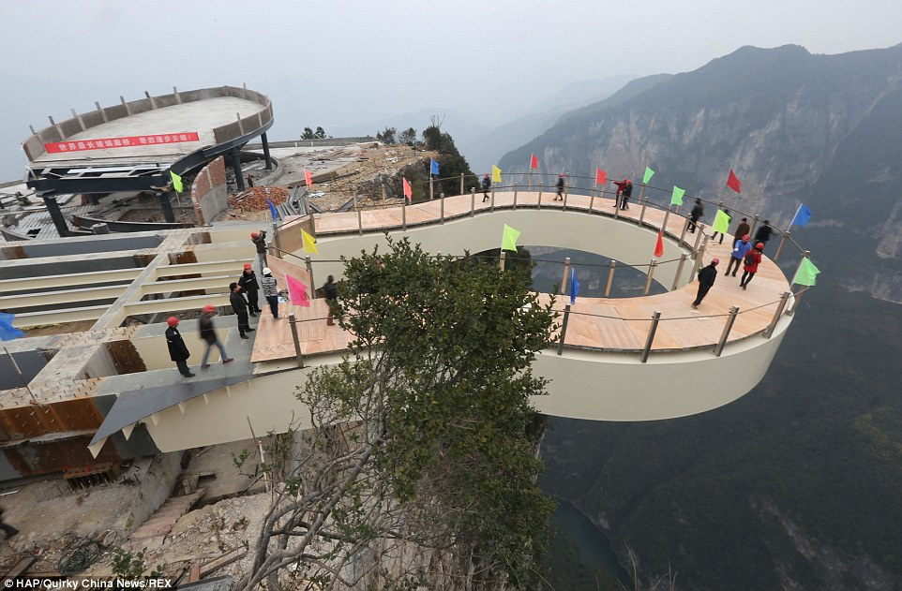
Sometimes your first attempt at a proof will not get you anywhere new
http://i.dailymail.co.uk/i/pix/2015/03/09/2660CB3E00000578-2986435-Overhang_The_cantilevered_platform_in_Chongqing_measures_27_metr-a-16_1425912217904.jpg

Slide 16
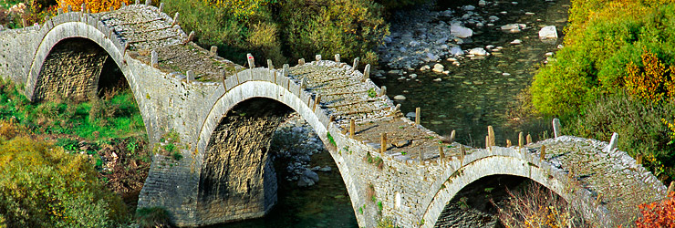
The ancient Greeks built bridges that are still standing today
http://www.aristi.eu/en/location

Slide 17
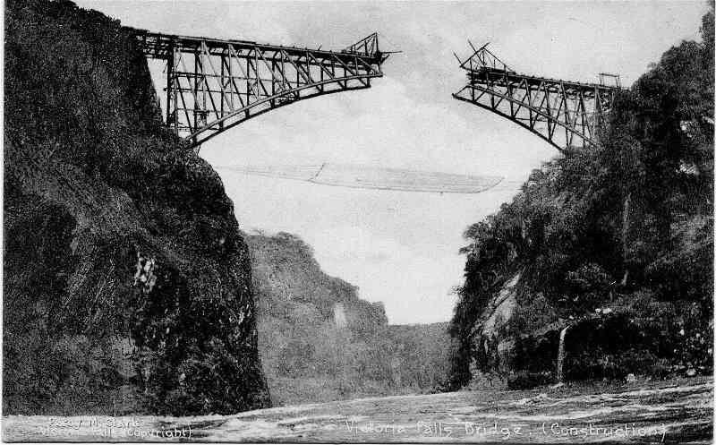
Sometimes we work on a proof like this: start from each side and try to meet in the middle
http://www.geoffs-trains.com/Bridge/bridgeconstruction.html

Slide 18
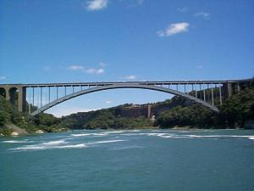
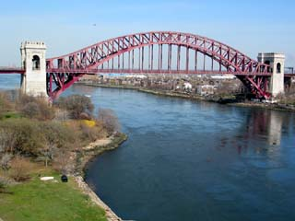
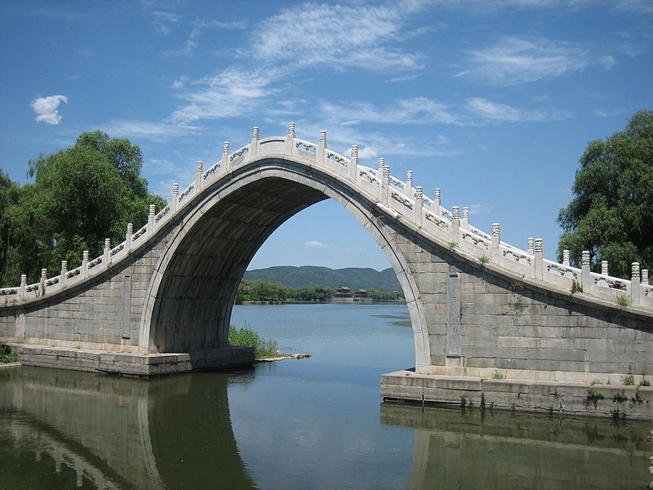
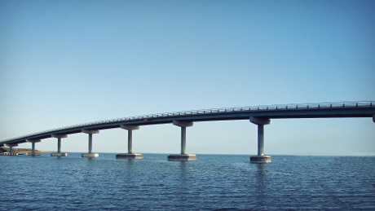
Bridges come in many styles …
http://thelinkbetween.wordpress.com/2011/02/16/bridge-building/
http://wirednewyork.com/bridges/hell_gate_bridge/
http://www.themebin.com/hd-wallpapers/bridge-hd-wallpaper-5/
http://en.wikipedia.org/wiki/File:Gaoliang_Bridge.JPG

Slide 19
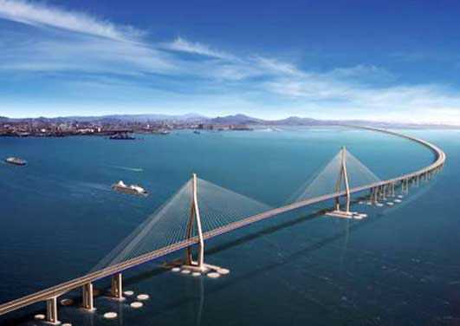
… and so do proofs

Slide 20
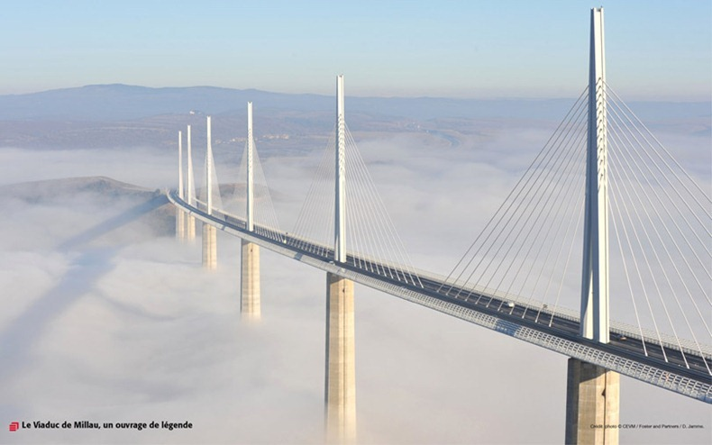
Some are works of art
http://www.amusingplanet.com/2012/03/millau-viaduct-france-tallest-bridge-in.html

Slide 21
In this class we will write proofs that:
Are reliable
Are not missing steps
Do not have extra steps
Are a pleasure to go through

